Slide 1





The Business Environment
Business organizations: The external environment

Slide 2
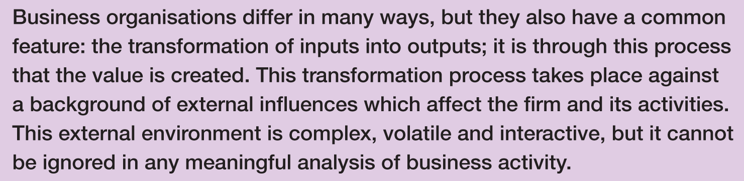

Introduction

Slide 3
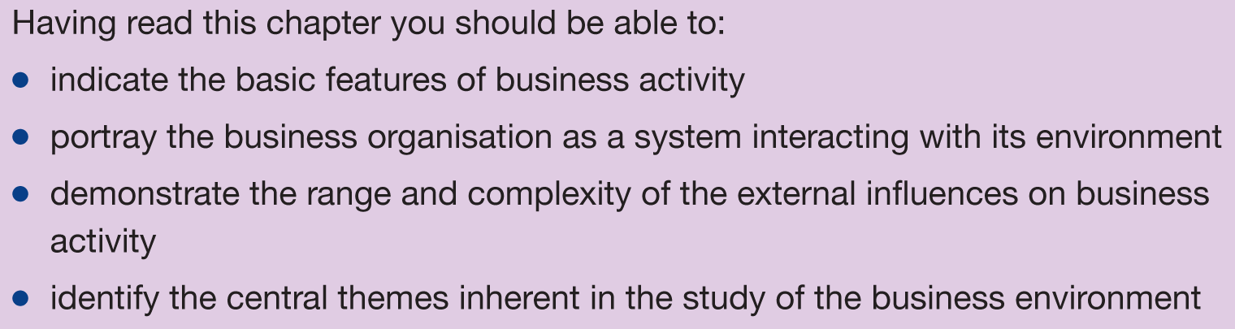
Learning outcomes

Slide 4
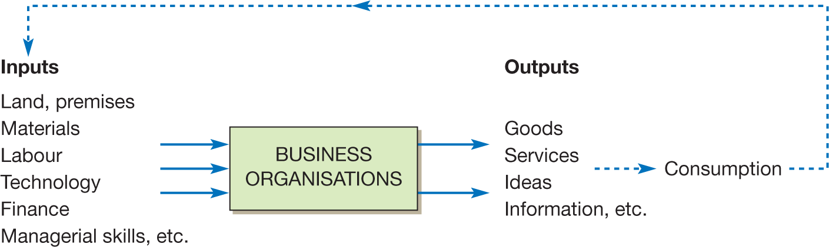
The business organization as a transformation system

Slide 5
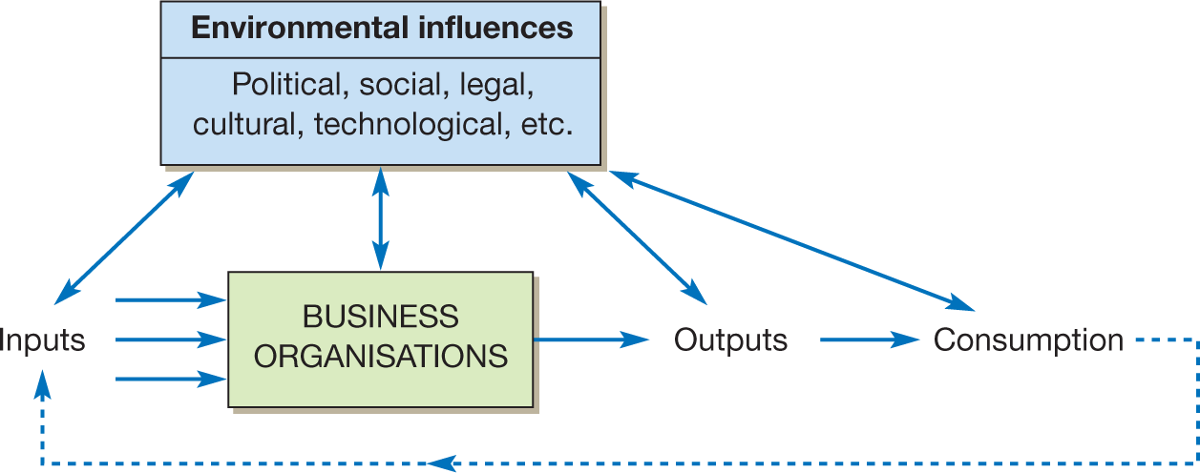
The firm in its environment

Slide 6
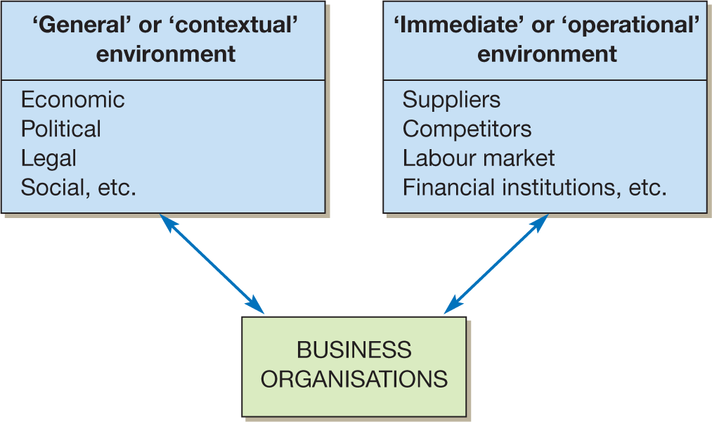
Two levels of environment

Slide 7
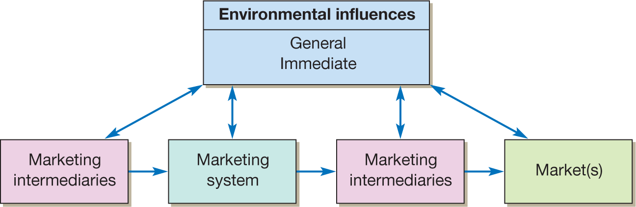
Environmental influences on a firm’s marketing system

Slide 8
PESTLE ANALYSIS
PESTLE Analysis (political, economic, social, technological, legal and environmental) is a management method whereby an organization can assess major external factors that influence its operation in order to become more competitive in the market. As described by the acronym, those six areas are central to this model. It offers people professionals insight into the external factors impacting their organization.

Slide 9
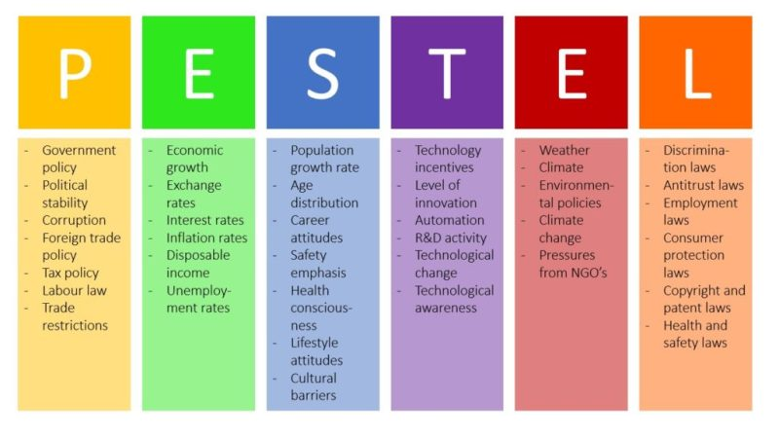

Slide 10
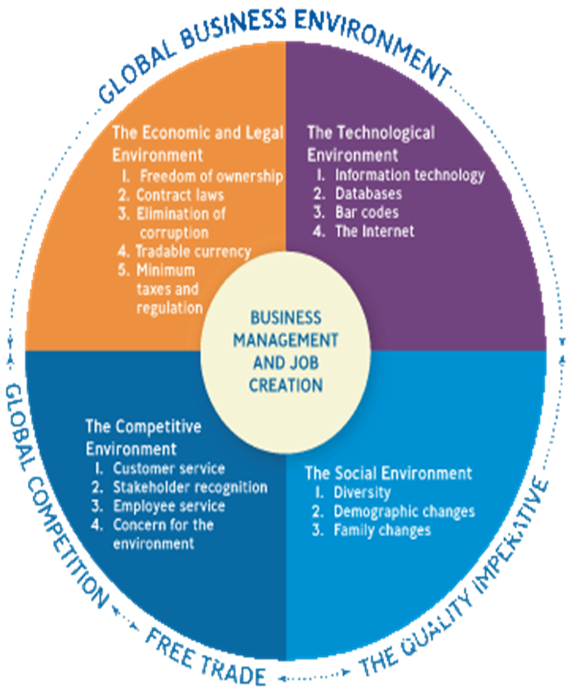
Business Environment
The Business Environment is the sum total of all external and internal factors that influence a business. An external business environment is composed of all the outside factors or influences that impact the operation of business.
*
Notes:
Copyright @2020 Nusrat Hafiz. All Rights Reserved.
Introduction to Business (BUS 101). Course Instructor: Nusrat Hafiz (NHF)

Slide 11


1. Economic & Legal Environment
1-<number>
Notes:
Copyright @2020 Nusrat Hafiz. All Rights Reserved.
Introduction to Business (BUS 101). Course Instructor: Nusrat Hafiz (NHF)

Slide 12
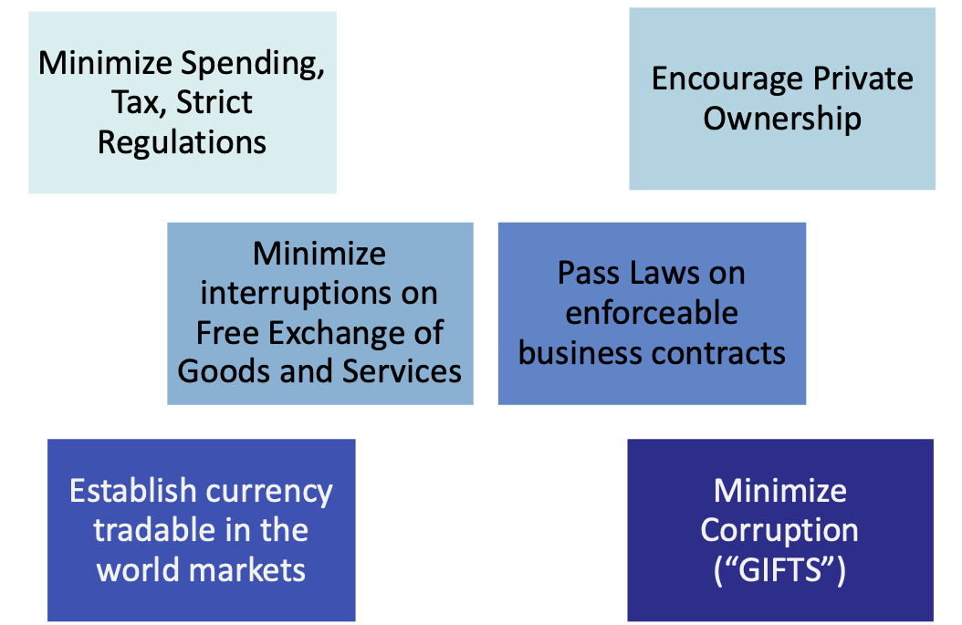
1. Economic & Legal Environment
Government actions which affects the operations of a company or business. A government can promote business through:
1-<number>
Notes:
Copyright @2020 Nusrat Hafiz. All Rights Reserved.
Introduction to Business (BUS 101). Course Instructor: Nusrat Hafiz (NHF)

Slide 13


2. TECHNOLOGICAL ENVIRONMENT
Food for thought: Does being busy means being productive?
https://youtu.be/HPLBwuj7sMA
1-<number>

Slide 14
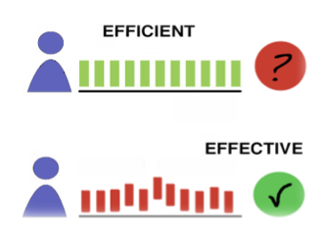
2. TECHNOLOGICAL ENVIRONMENT
Technology -- Everything from phones to copiers and the various software programs that make businesses more effective, efficient and productive.
Effectiveness -- Producing the desired result (doing the right things)
Efficiency -- Producing goods and services using the least amount of resources. (doing thing right)
Productivity -- The amount of output you generate given the amount of input (example: hours you work).
1-<number>

Slide 15

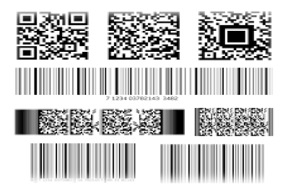
BENEFITS of TECHNOLOGY
E-Commerce-- The buying and selling of goods
and services over the internet.(B2B, B2C).
Universal Product Code helps scan what product
was bought, in what size and color and at what price.
A scanner at the checkout counter can read that
information and put it into a Database, which is an
electronic storage file where vast amounts of information
about customers (name, address, telephone numbers) are
stored.
Identity theft is the obtaining of individual personal
information for illegal purpose.
1-<number>

Slide 16


3. COMPETITIVE ENVIRONMENT
Firms should offer both high quality product and outstanding services at competitive price.
Need to know the competitors
1-<number>

Slide 17
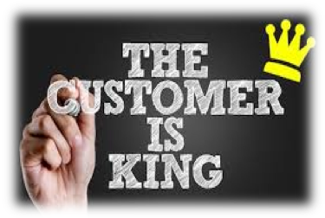

3. COMPETITIVE ENVIRONMENT
Two ways to compete:
by exceeding customer expectations
by restructuring and empowering the employees
1-<number>

Slide 18


4. SOCIAL ENVIRONMENT
  Demography is the statistical study of human population with regard to size, density and other characteristics, i.e., age, race, gender & income.
  - Diversity has grown from just recruiting minority and female workers.
  - Two income families
  Changes in customers’ tastes and preferences
1-<number>

Slide 19


5. GLOBAL ENVIRONMENT
  Significant changes in global environment are
  Contributed by:
  Increase of global competition
  Increase of free trade among nations
1-<number>

Slide 20



5. GLOBAL ENVIRONMENT
  Negative effects of globalization on businesses:
  Wars and terrorism
  Global Pandemic
  How to stay updated with globalization?
1-<number>

Slide 21


6. Ecological Environment
The Ecological Environment
L
  More than just climate change
  Greening: The trend toward saving energy and producing products that cause less harm to environment.
1-<number>

Slide 22
Environmental influences on a firm’s marketing system

Slide 23
SWOT ANALYSIS
SWOT Analysis is a simple but useful framework for analyzing your organization's strengths, weaknesses, opportunities, and threats. It helps you to build on what you do well, to address what you're lacking, to minimize risks, and to take the greatest possible advantage of chances for success..

Slide 24
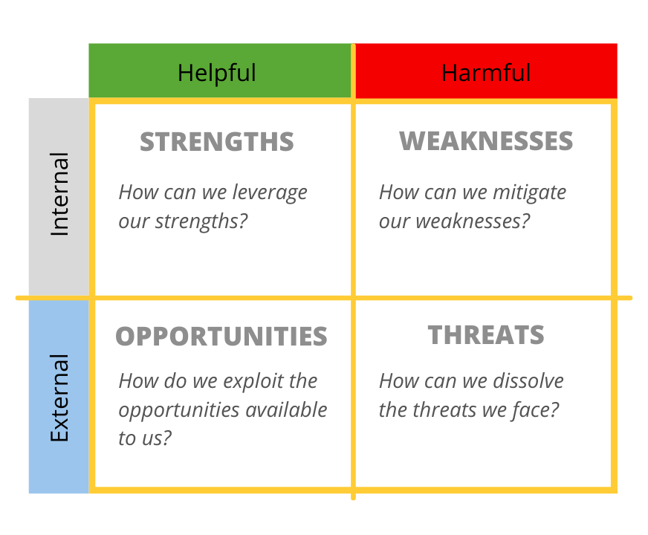
SWOT ANALYSIS

Slide 25
